Slide 1

NFTY
Raj Tolani, Jack Willis, Robert Smith, Kai Huang, Olivia Heitz, Niko Korolog

Slide 2
Intro
Team Members:
Raj Tolani, Jack Willis, Robert Smith,
Kai Huang, Olivia Heitz, Niko Korolog
____________________________________________________________________
Problem: We needed a cryptographically secure way to track shipment logistics and verify shipment integrity along all points of supply chain
Our solution: We used an NFT token to represent a shipment and multiple wallets representing logistic / supply chain checkpoints
___________________________________________________________________

Slide 3
Why?
Blockchain based platform for secure booking, tracking and Management of Freight shipments across the globe - Based on the Ethereum network - Use smart contracts
Goal: track shipments around the world from point A to point B by making an NFT for each shipment.
Why:
Tracking Responsibility /physical possession of shipment
When the shipment is live, the nft is created for it
How to track from warehouse-truck-ship-truck-warehouse-delivery
More complex: Contract can have logic (shipment is urgent or not)
Logic needs to depend on cost, time (in transit), and urgency
Participants:
Manufactures/Shippers
Transportation Companies
Airline
Shipping Lines
Truckers
Brokers
Insurance Companies - function in contract verifying
Financial Institutions

Slide 4
Value Proposition:
Using an NFT token to represent a shipment and multiple wallets representing logistic / supply chain checkpoints is an innovative new way to solve shipping and supply chain logistics tracking. Instead of keeping track of shipments in a centralized database or spreadsheet, we propose using NFTs and crypto wallets on a private network as a combination shipping documentation AND representational model of the supply chain network. An NFT will be transferred between wallets representing different supply chain checkpoints that model the actual physical shipping network, along with documentation for the shipment’s contents and other metadata, for instance tamperproofing. Built on a private network rather than the public Eth network to eliminate gas fees, the NFT/Checkpoint Wallet system is an inexpensive, secure, and elegant solution for tracking shipping logistics.

Slide 5
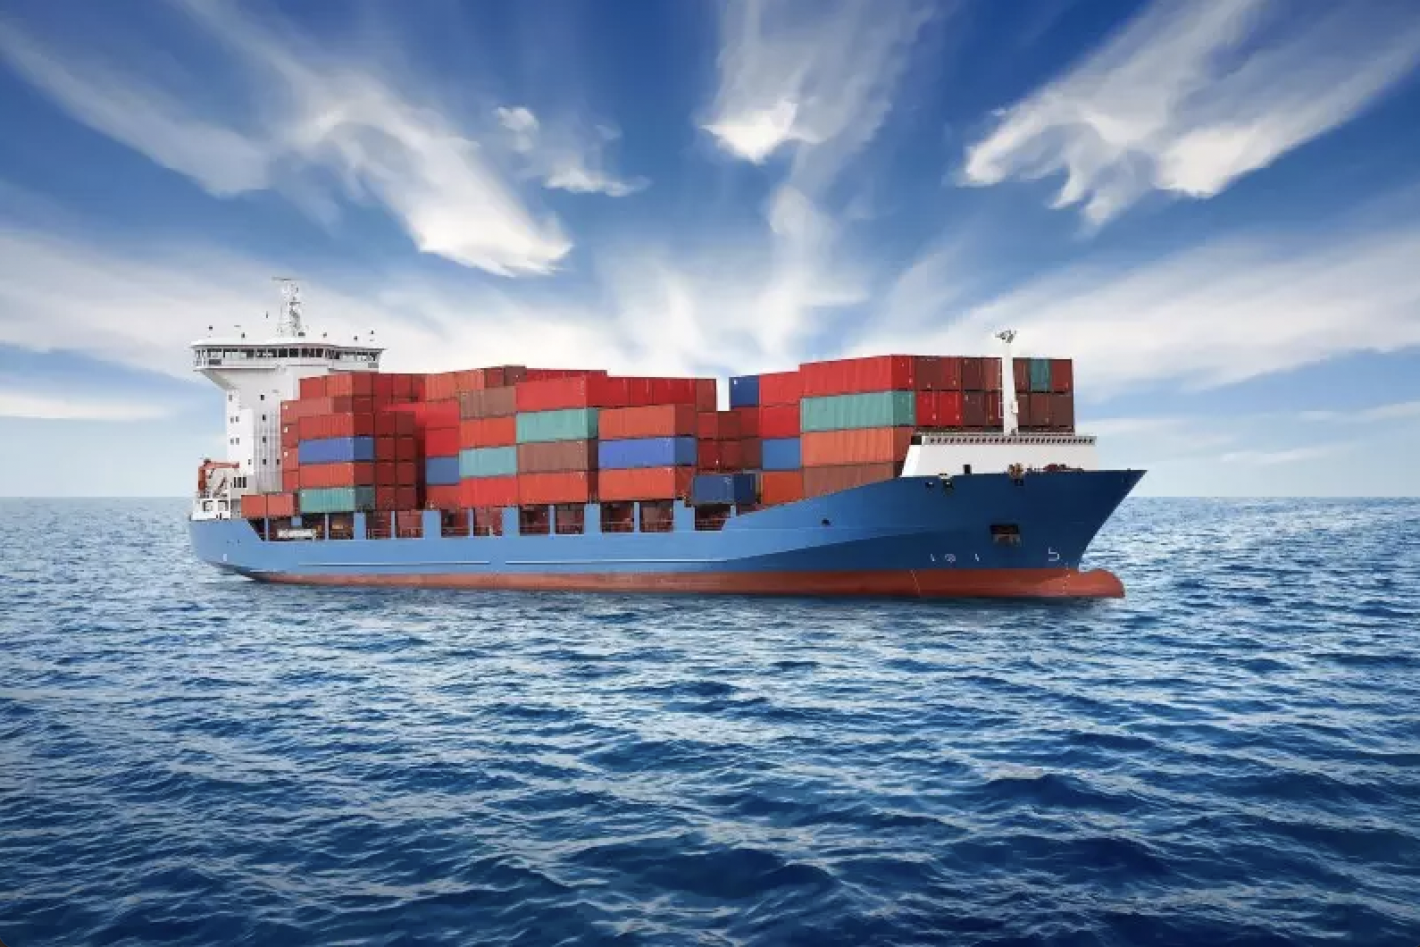
Technical Overview (Raj)
Agenda
Piñata
Streamlit
Demo
ERC721
Assumptions
Next Steps

Slide 6
Pinata - decentralized storage of shipment data
What’s in the IPFS (Cloud)
Shipment contents
Product serial number to guarantee authenticity
Order informations and destinations
Connecting application like streamlit
Create Pinata API keys
Create Functions
pin_file_to_ipfs
pin_json_to_ipfs
convert_data_to_json

Slide 7
Streamlit (Raj & Kai) Frontend Application
Users to kick off shipping process
Check which shipping partners have the packages
Shipping company logs and when packages change hands

Slide 8
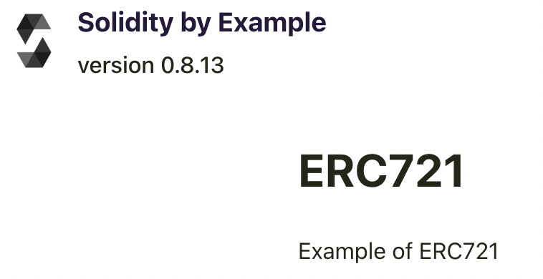
ERC721
Robert, Olivia, & Jack
How we used ERC271 as a guide to structure our sol file
Review sol file

Slide 9
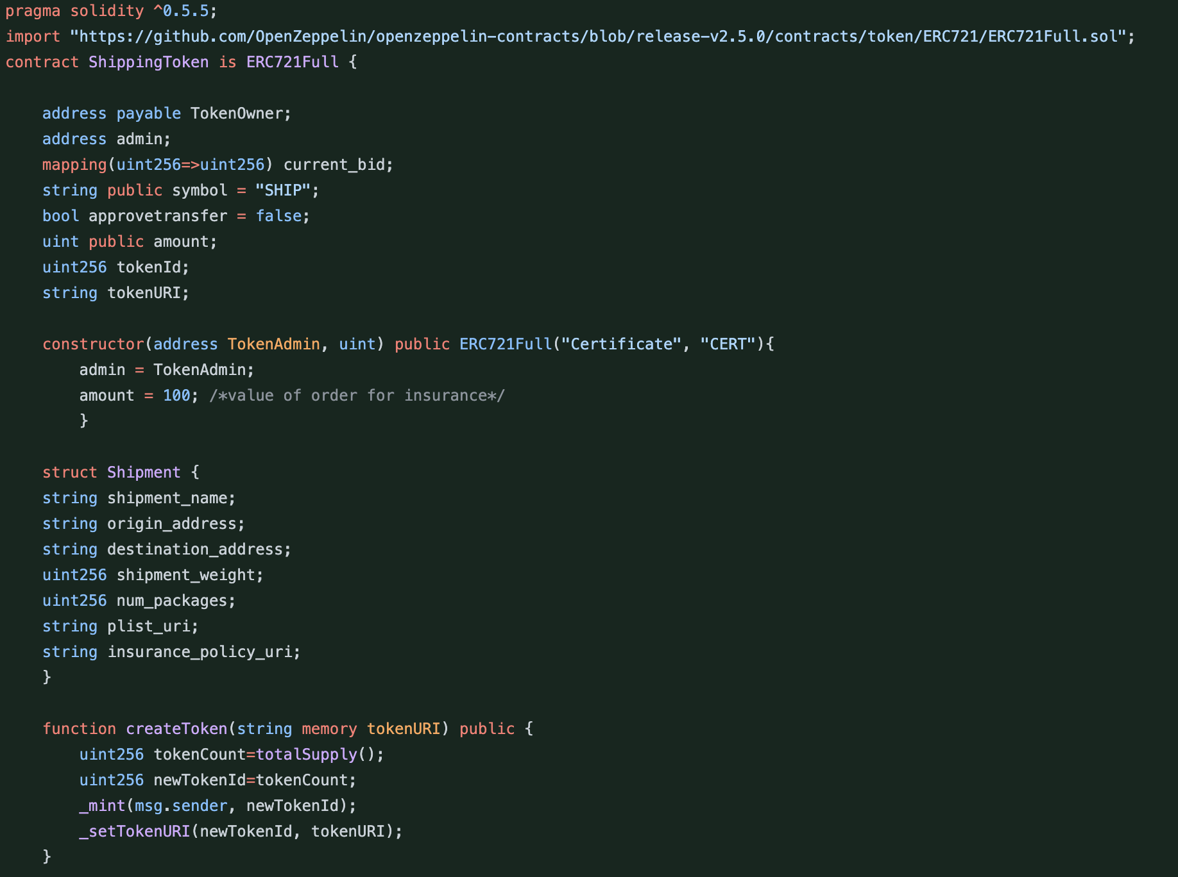
Creating our ERC 721 SHIP Token
ShippingToken contract is created on ERC 721
Define data structure for NFT via struct
SHIP token is minted

Slide 10
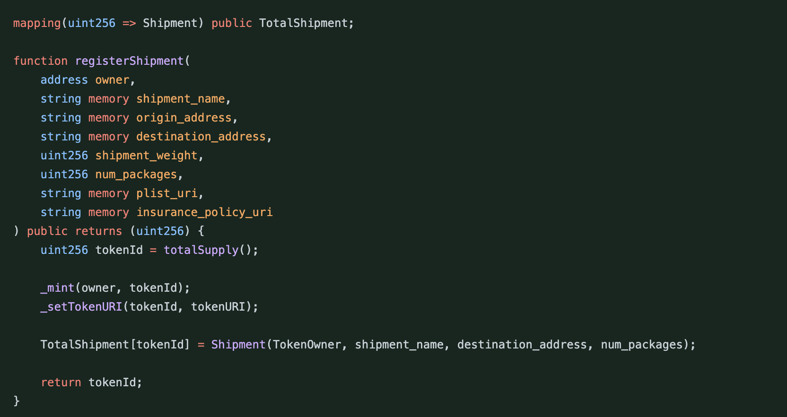
registerShipment function
Allows shipment creator input shipping details that get registered on the chain

Slide 11

Key Assumptions
A real system like this would require use of smart sensors and GPS devices on the shipment. For this project we will not have the time and the financial resources required to implement the tracking of location and condition of goods during transit
The insurance provider is the 3rd party verifier
Notes:
Transfer: allows the owner to transfer the token to the next mode of transportation
Approve: allows current TokenOwner/Mode of transport to approve transfer to the next owner/ mode of transport
balanceOf: Returns number of shipments (tokens) owned by the current token owner
getInsuranccertificatel: requires approval from insurance company

Slide 12
Next Steps
Oh the things we could achieve with more money!
SO MUCH TO BE DONE!
If we had the $$$$$$$$$$$$
Hire lots of engineers
Put monitoring systems in place
Create company roadmap
Change the shipment tracking industry for good

Slide 13
Tools for this project
Solidity - Smart Contracts
Ganache [Blockchain Simulator - Alternatively use actual Eth live testnet]
Streamlit
Web Browser
Metamask
Remix
ERC271

Slide 14
Questions?

